Slide 1
Inovativni proizvodi i rješenja na bazi vapna za sanaciju povijesnih građevina
HRVATSKA KOMORA INŽENJERA GRAĐEVINARSTVA
Dani Hrvatske komore inženjera građevinarstva Opatija, 2018.
Davide Bandera
Davide Bandera, Mapei SpA, Italija
Notes:
1

Slide 2
To solve the problems that affect a historical building and to address properly the remedial action it is necessary to carry out:
1. ANALYSIS
2. DIAGNOSTIC INVESTIGATIONS
3. CHOICE OF THE MATERIALS
4. DEFINITION OF THE APPLICATION METHODOLOGIES

Slide 3
1. ANALYSIS
An analysis is necessary, since it is directed to collect historical data on the structure and information on the materials which compose the historical buildings and on their state of conservation

Slide 4
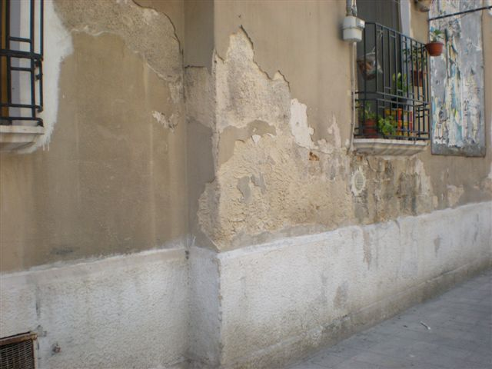
MATERIALS DEGRADATION

Slide 5
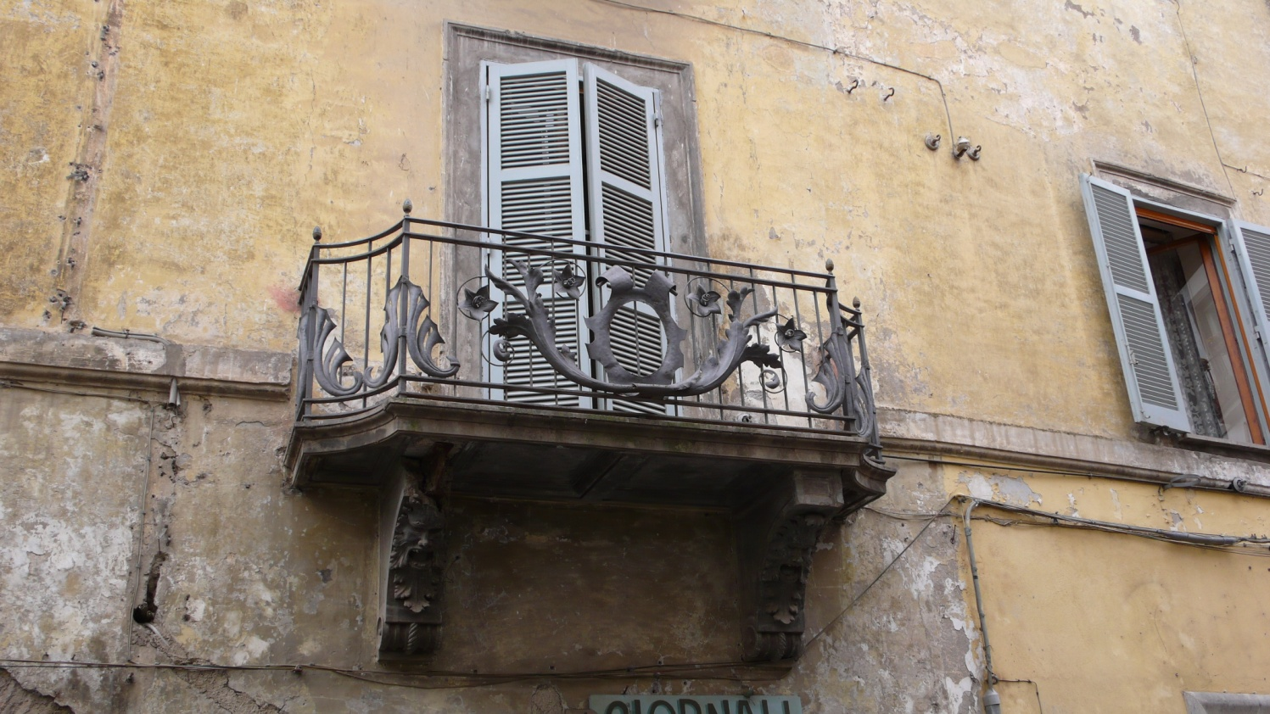
MATERIALS DEGRADATION

Slide 6
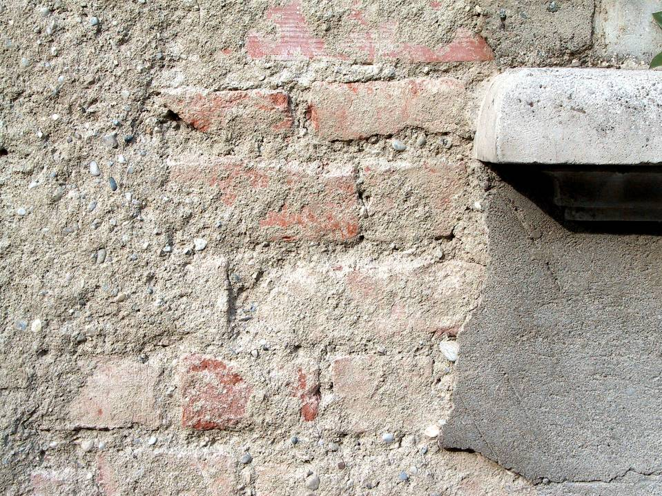
MATERIALS DEGRADATION

Slide 7
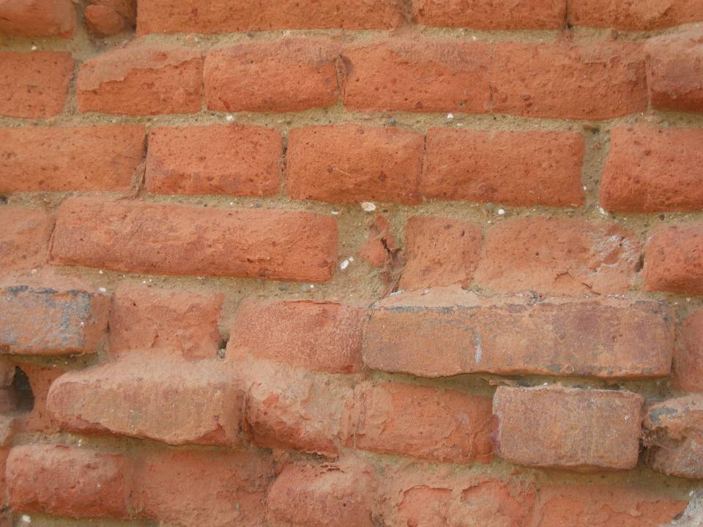
MATERIALS DEGRADATION

Slide 8
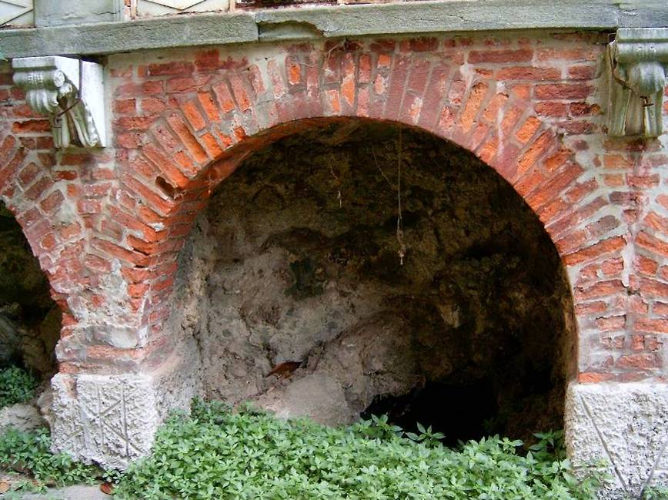
MATERIALS DEGRADATION

Slide 9
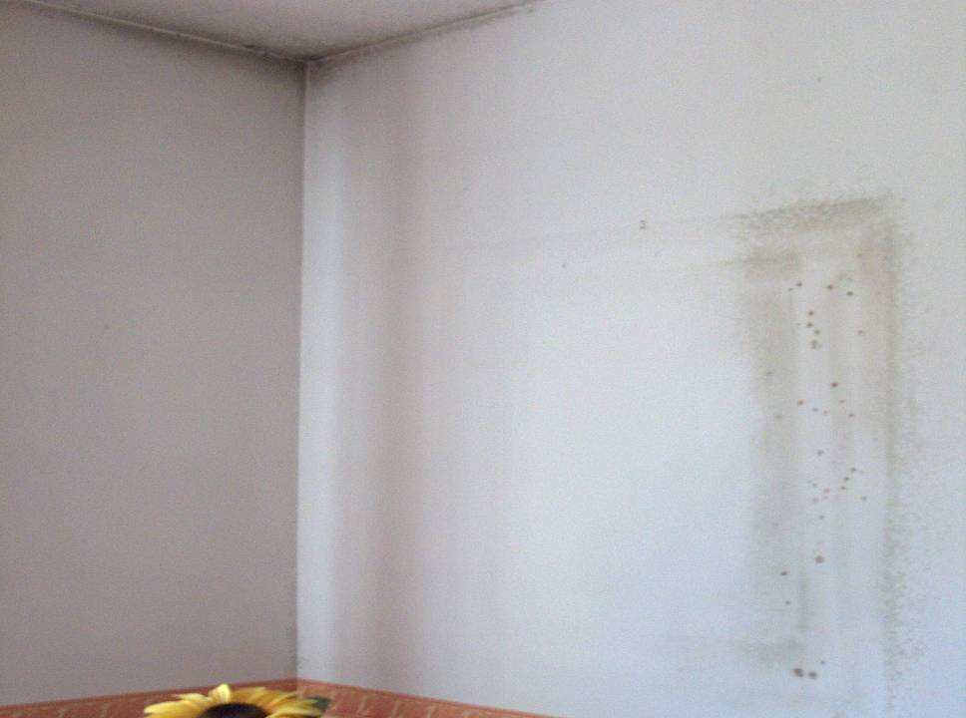
REDUCTION OF THE THERMAL COMFORT

Slide 10
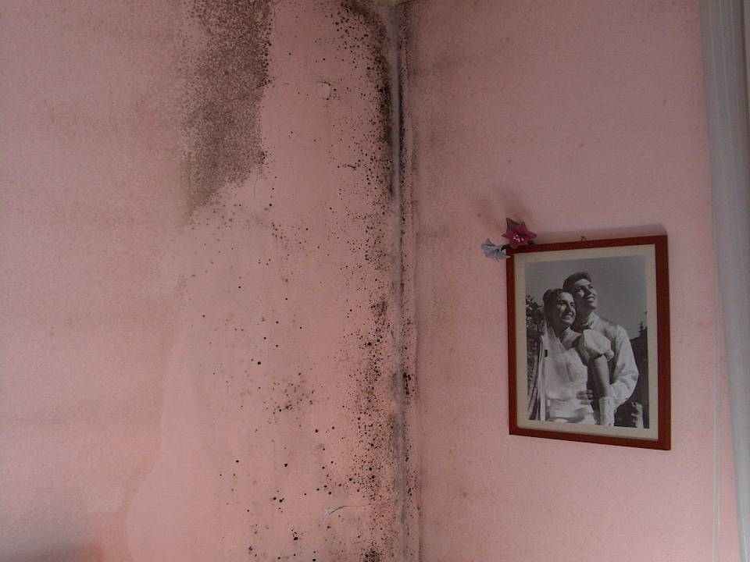
REDUCTION OF THE HYGIENIC COMFORT

Slide 11
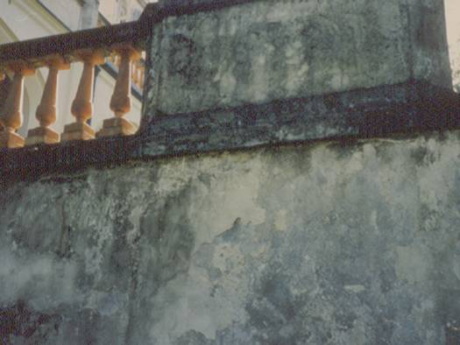
MOULDS AND ALGAE

Slide 12
EFFLORESCENCES

Slide 13
2. DIAGNOSTIC INVESTIGATIONS
Through numerous and complex chemical analyses the diagnosis is used to evaluate the degradation state of the materials and to define its causes, in order to allow the restorers to act on the origin of the phenomenon

Slide 14
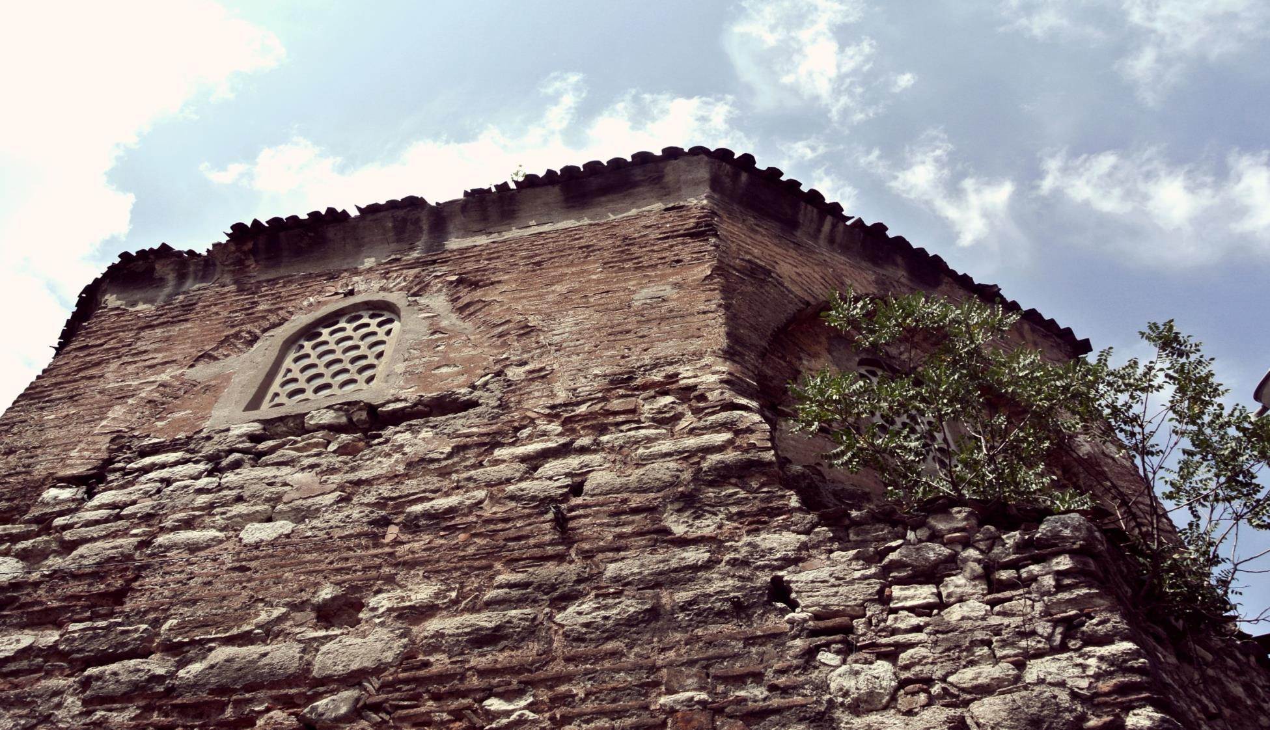

Slide 15
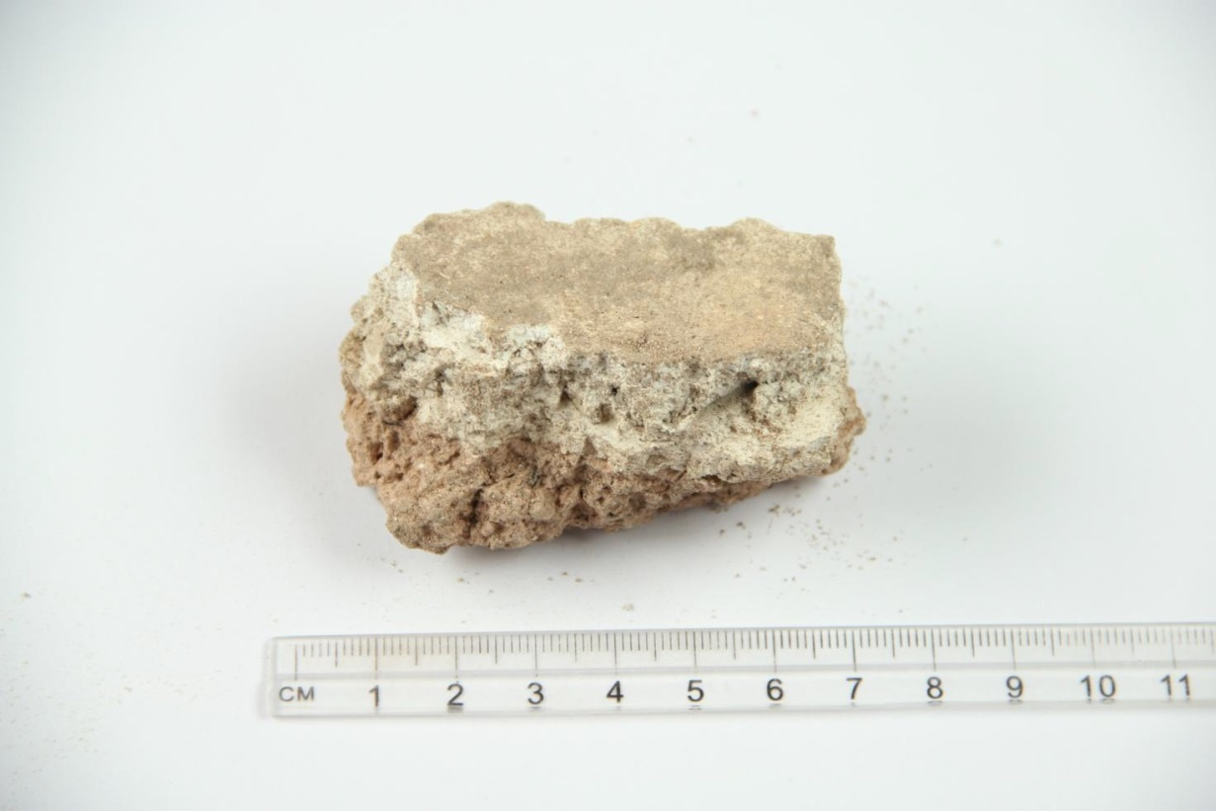

Slide 18
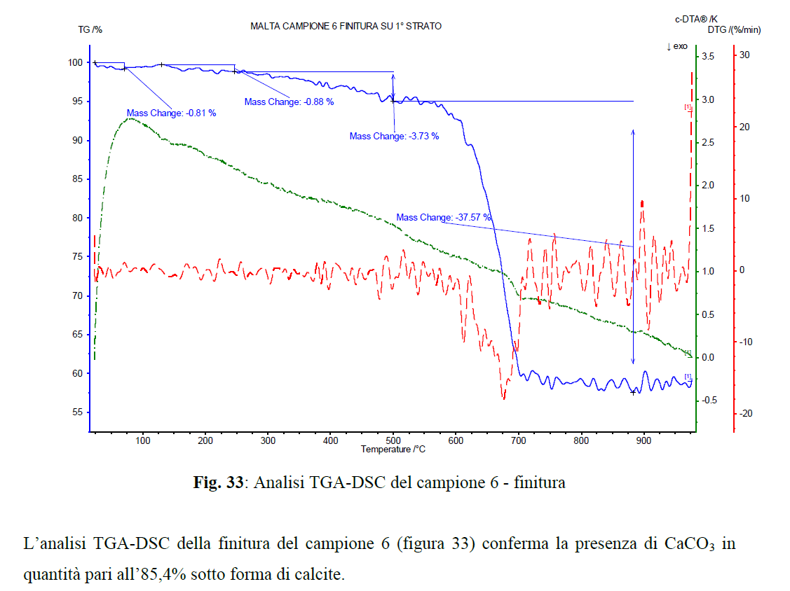

Slide 20
3. CHOICE OF MATERIALS
It is a very important operation, since the materials chosen should be both reversible and should respect the historical building which is going to be restored.
In short, these should be compatible with the original materials from a chemical, physical, mechanical and an elastic point of view

Slide 22
ICOMOS CHARTER
Art. 3.9 Where possible, any measures adopted should be “reversible” so that they can be removed and replaced with more suitable measures when new knowledge is acquired
Art. 3.10 The characteristics of materials used in restoration work (in particular new materials) and their compatibility with existing materials should be fully established. This must include long-term impacts, so that undesirable side-effects are avoided

Slide 23
ICOMOS CHARTER
Art. 5.2 Particular attention has to be given to the compatibility between original and new materials
Cements containing salts can only be used when there is no risk of damage to the masonry and particularly to its surfaces
There may be a problem of leaching of soluble salts from the mortar resulting in efflorescence on the surface of brickwork

Slide 24
4. DEFINITION OF THE APPLICATION TECHNIQUE
- It depends on the type of product chosen, which has to be applied correctly according to the recommendations given by the producer
- If this is not followed, the results reached could be poor and the risk not to meet the required performances is rather high

Slide 25
MAPEI MATERIALS FOR THE RESTORATION OF HISTORICAL BUILDINGS
DEHUMIDIFYING RENDERS
STRUCTURAL RENDERS
TRANSPIRANT RENDERS
INJECTION SLURRIES FOR THE RE-ADHESION OF RENDERS, ALSO FRESCOED, TO WALLS
INJECTION SLURRIES FOR THE STRUCTURAL CONSOLIDATION

Slide 26
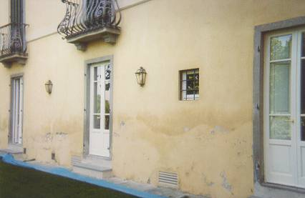
DEHUMIDIFYING RENDER

Slide 27
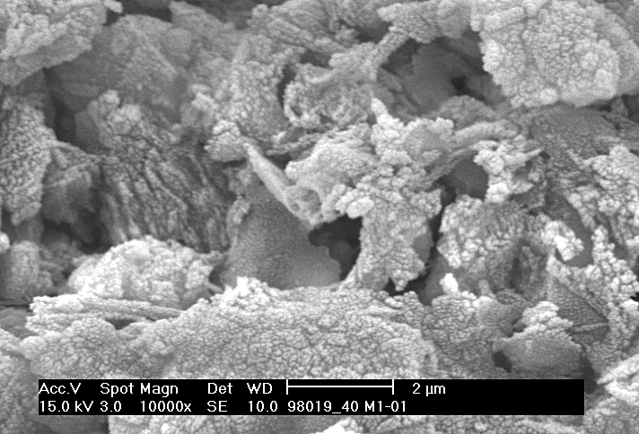
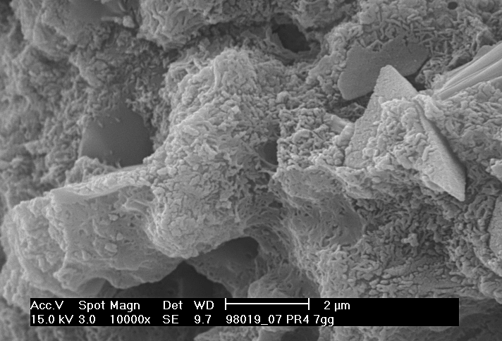
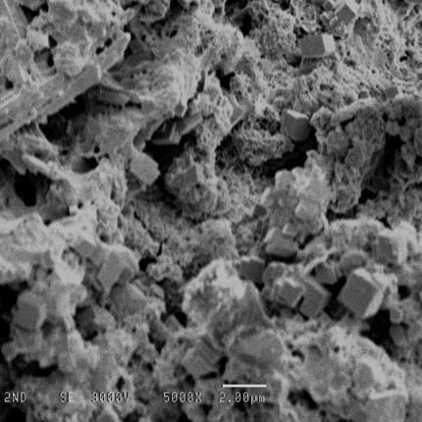
Morphological Compatibility
Mortar based on lime and pozzolan
( San Francis Basilica Assisi – Italy )
MAPE-ANTIQUE mortar
( after 8 days )
CEMENT
Notes:
This pictures makes a comparison between a pozzolanic mortar of the 13 th century and a mortar composed of Mapeantique after 8 days curing . As regards the morphology we don’t notice any particular difference between them and this is due to the fact that the lime that is present in Mapeantique reacts with all pozzolanic material with formation of calcium silicate

Slide 28
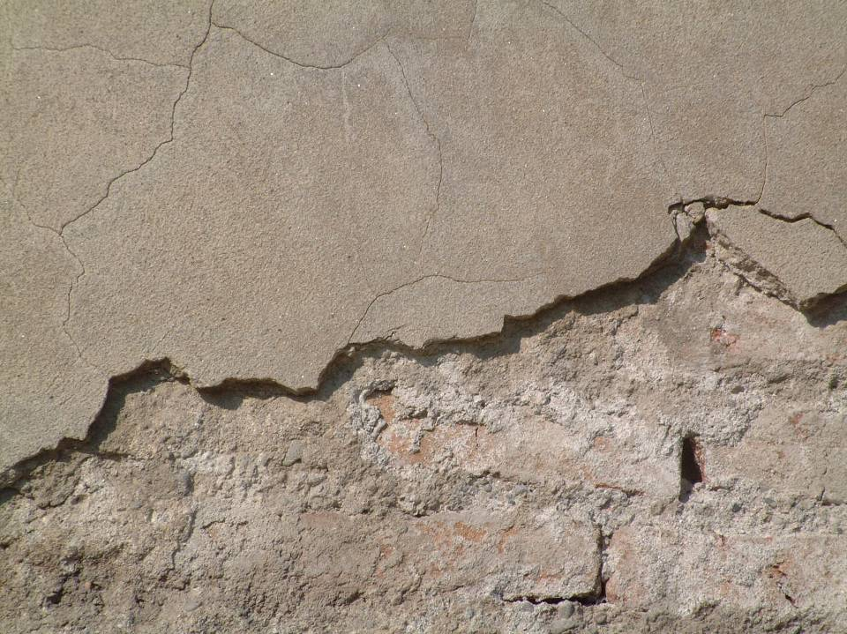
Elastic mechanical incompatibility

Slide 29
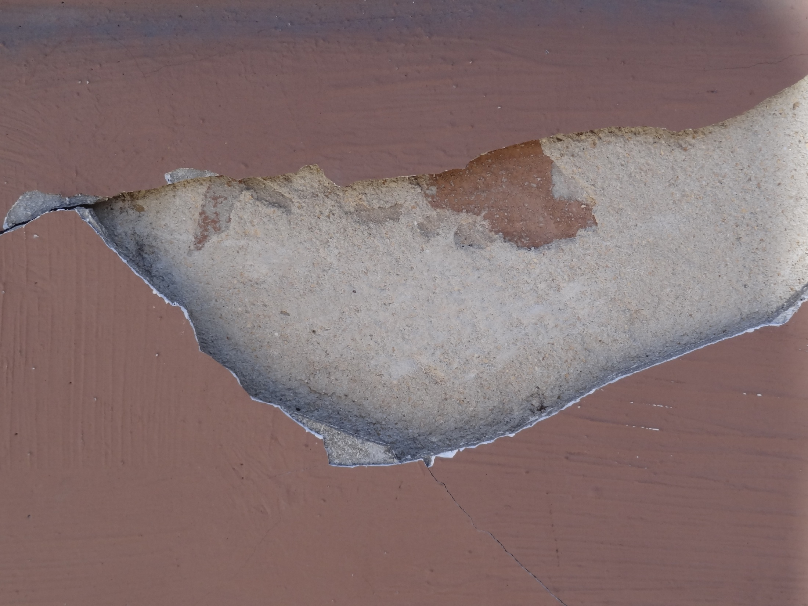
Elastic mechanical incompatibility

Slide 30
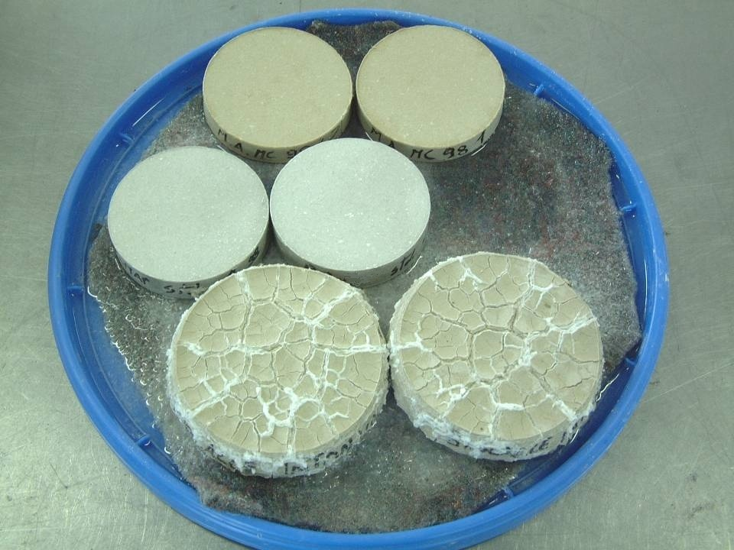
Resistant to Salts
M-A products are resistant to the soluble salts and in particular to sulphates, which means that there is no chemical reaction
M-A Dehumidifying render
MAPE-ANTIQUE Binder
PRODUCTS NOT RESISTANT TO SULPHATES
ANSTETT test – Resistance to suluble salts

Slide 31
Macropores technology
Without porosity, the volume increment of the salt crystals can cause the failure
Salt

Slide 32
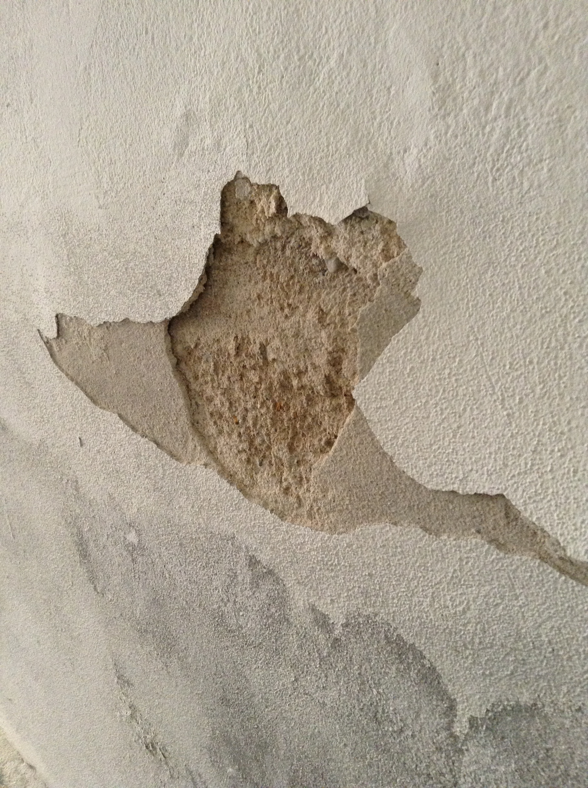
SUBFLORESCENCES

Slide 33
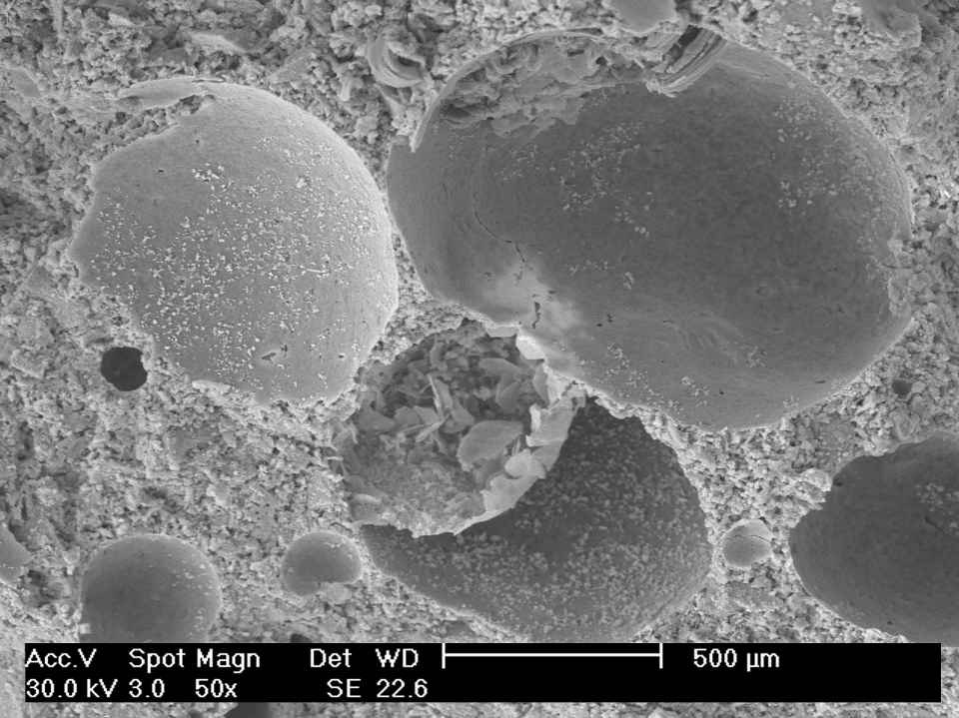
Macropores technology
Macropore

Slide 34
Macropores technology
Salt
Evaporation
The salt can crystallize in it
No degradation
What can MACROPORE do?

Slide 35
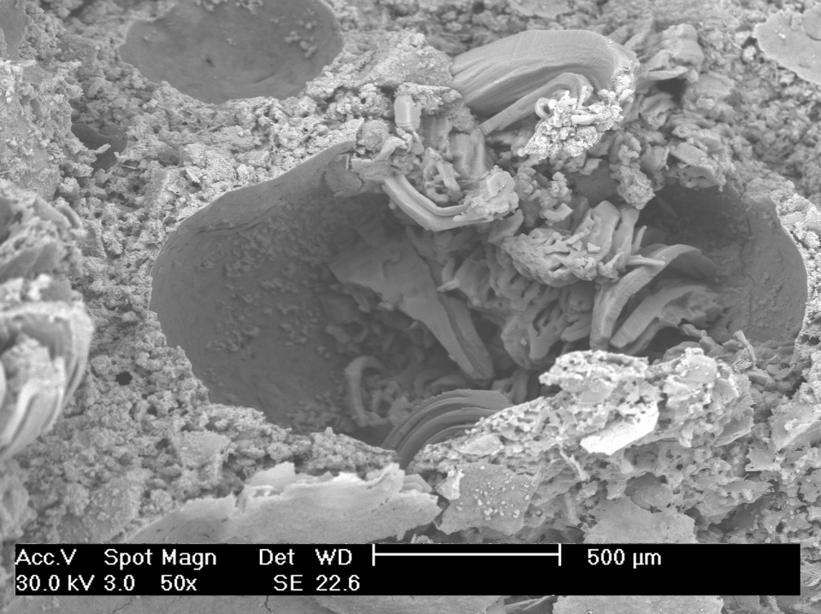
Macropores technology
Salt

Slide 36
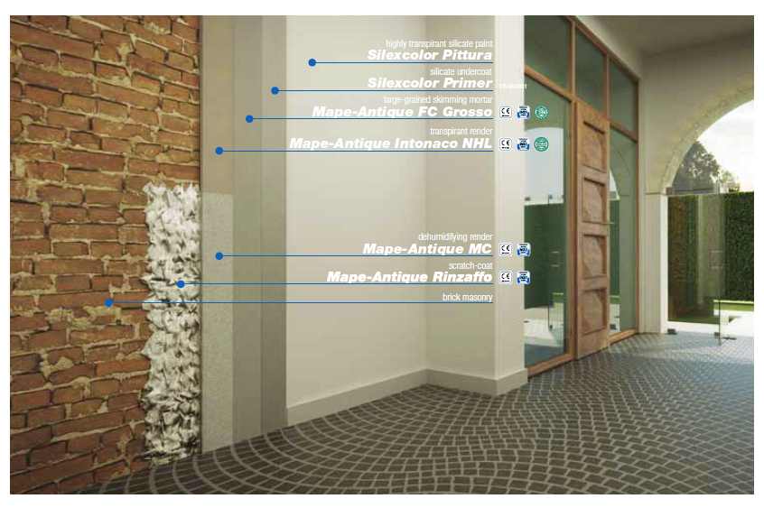
MAPE-ANTIQUE Full system solution

Slide 37
DEHUMIDIFYING RENDER Intervention procedure

Slide 38
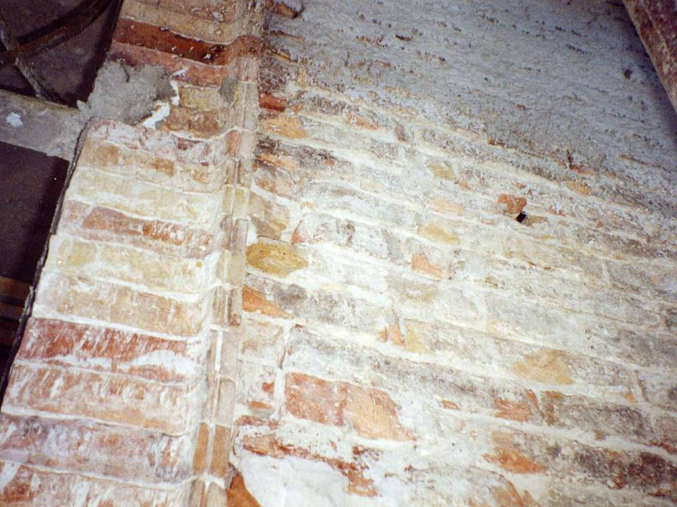
Removing the degraded render and washing carefully the surface

Slide 39
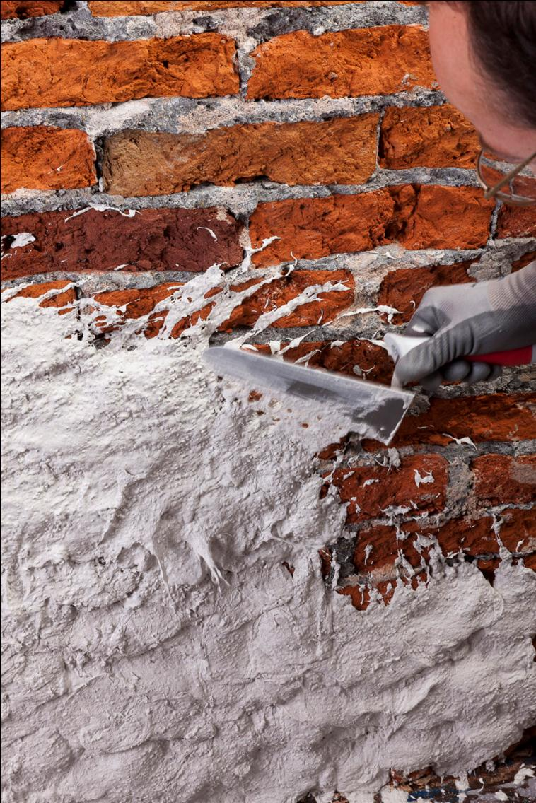
Application of the scratch coat mortar

Slide 40
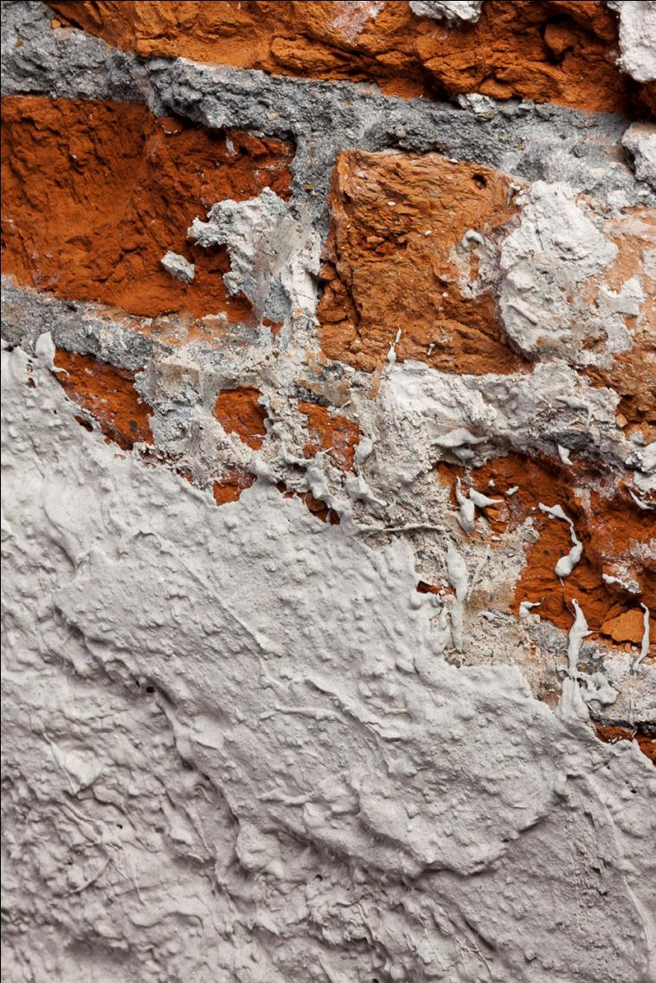
Detail of the scratch coat mortar

Slide 41
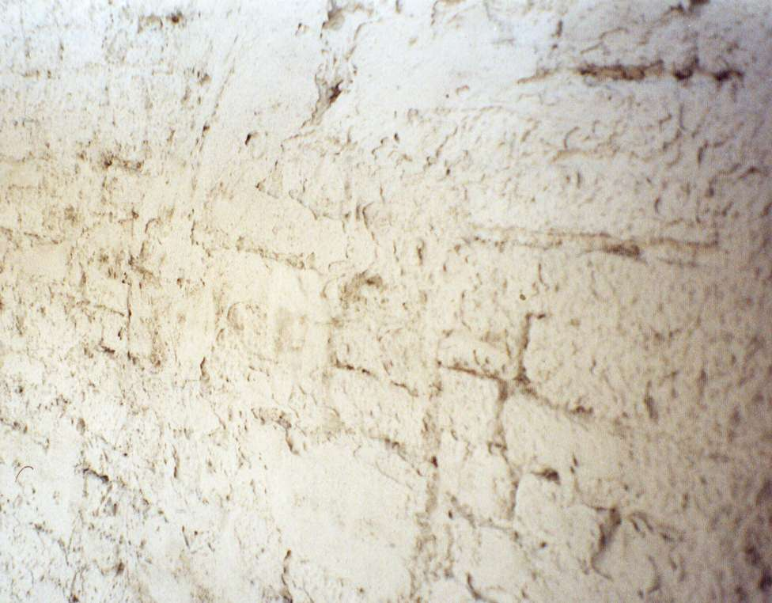
Application of the scratch coat mortar

Slide 42
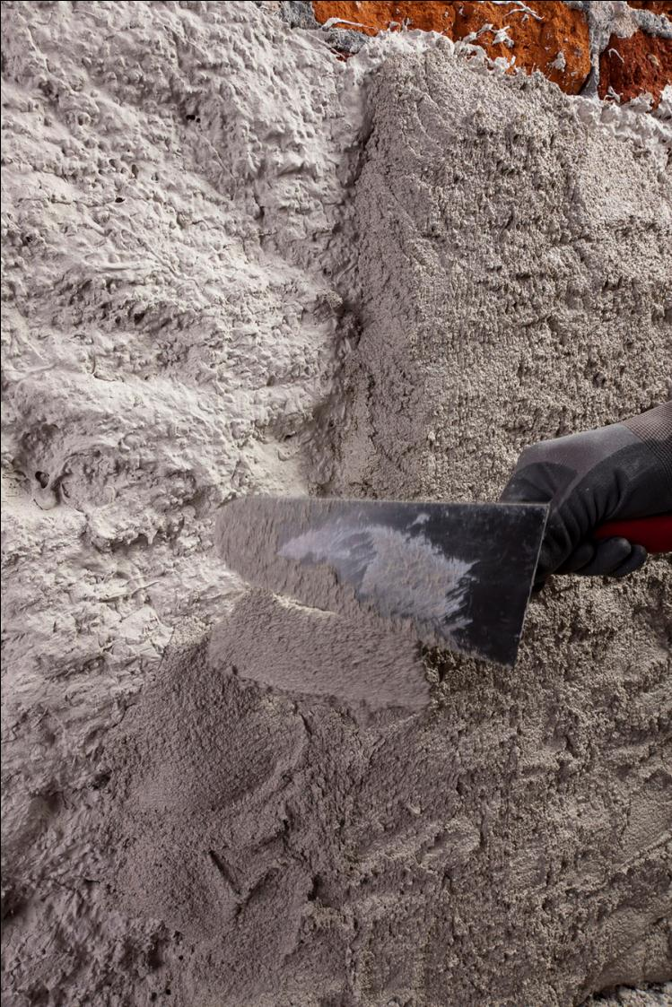
Application of the dehumidifying render

Slide 43
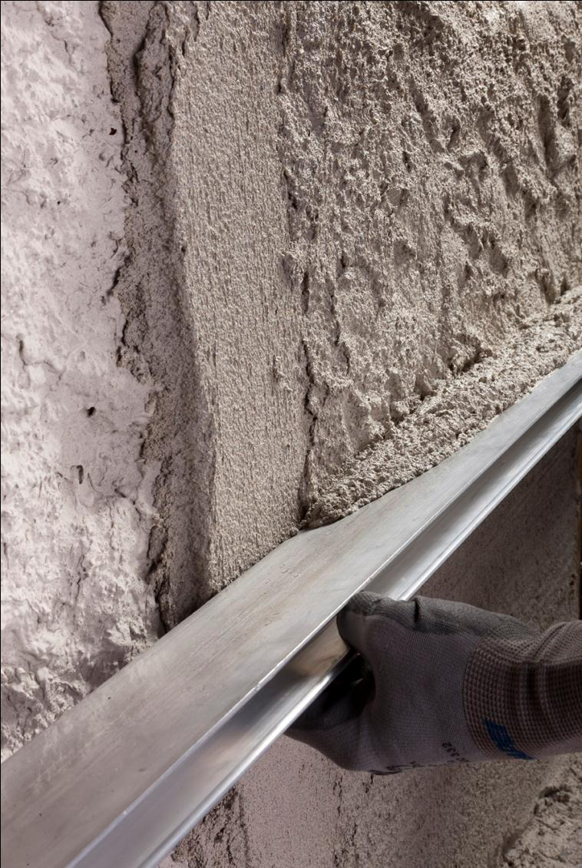
Squaring of the dehumidifying render

Slide 44
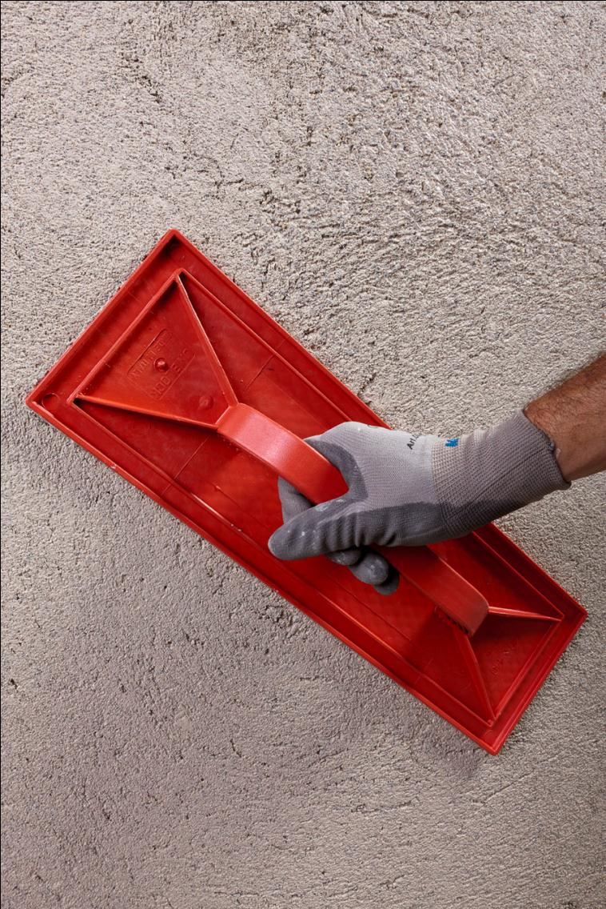
Levelling of the dehumidifying render

Slide 45
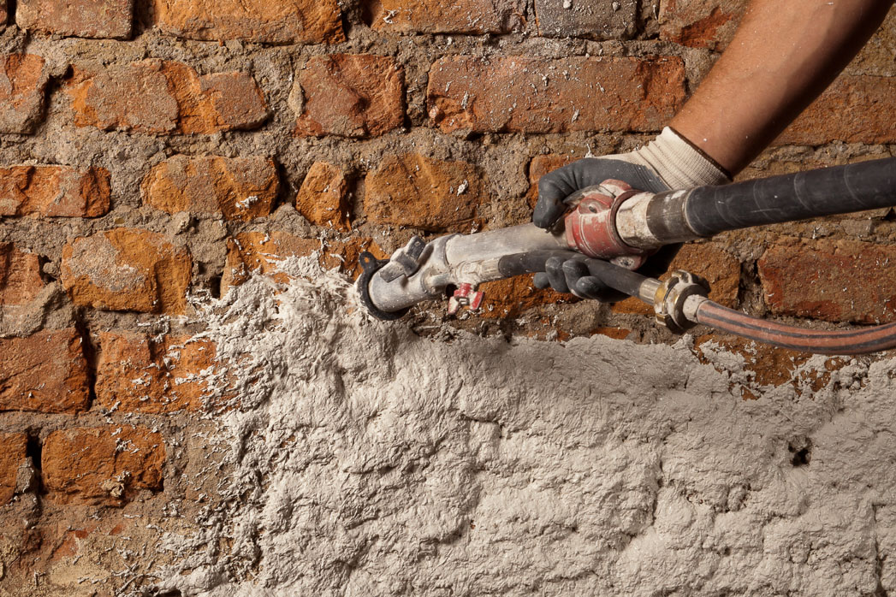
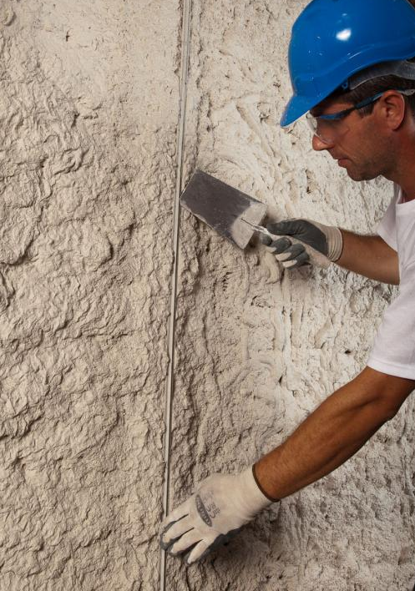
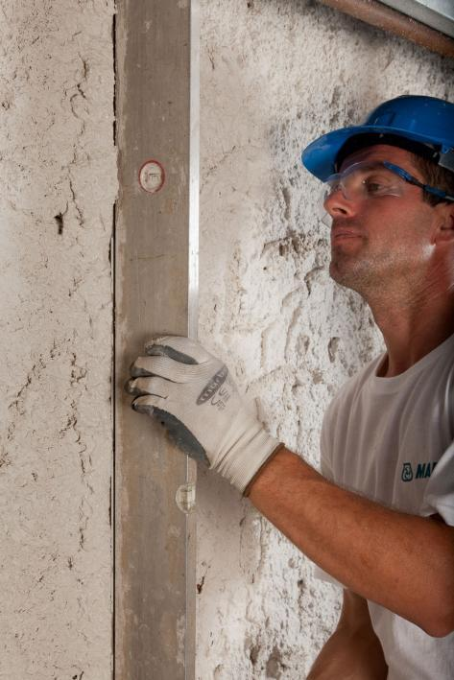
Application of the scratch coat mortar
Positioning a
vertical guide
Planarization of the
vertical guide

Slide 46
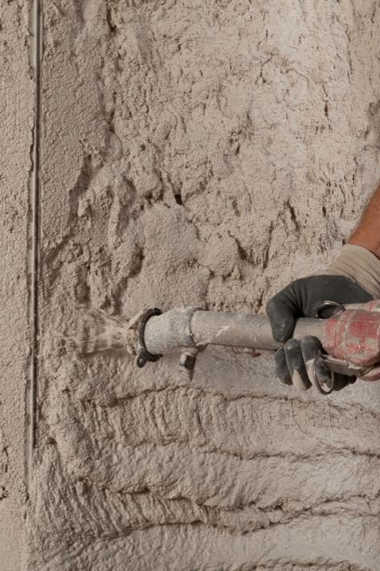
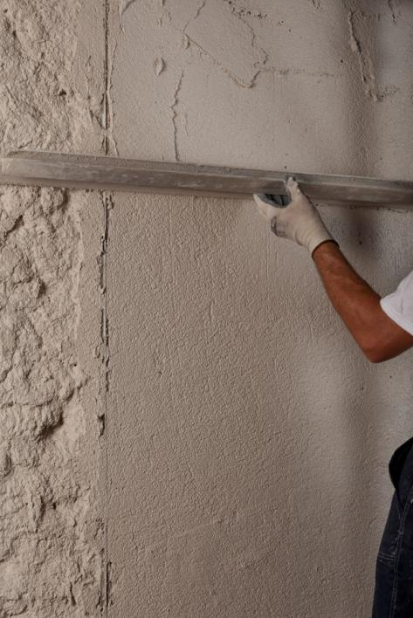
Application of the dehumidifying render by spray machine
Levelling of the dehumifying render with a straight edge
Removing the
vertical guide

Slide 47
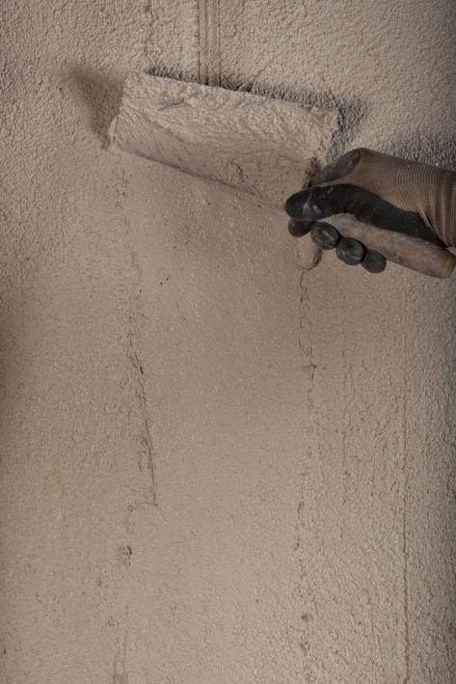
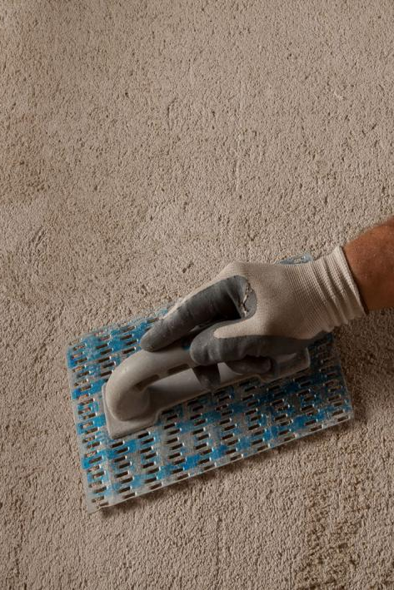
Filling of the voids after removing the vertical guide
Planing the surface of the dehumidifying render

Slide 48
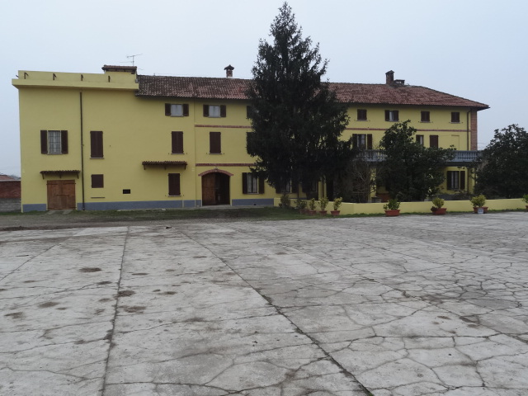
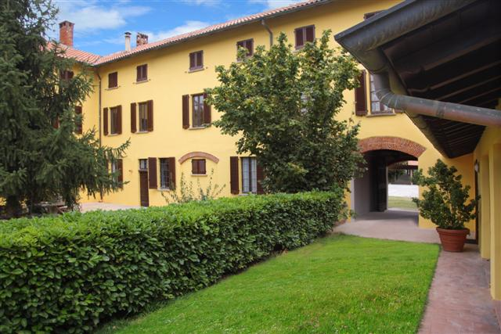
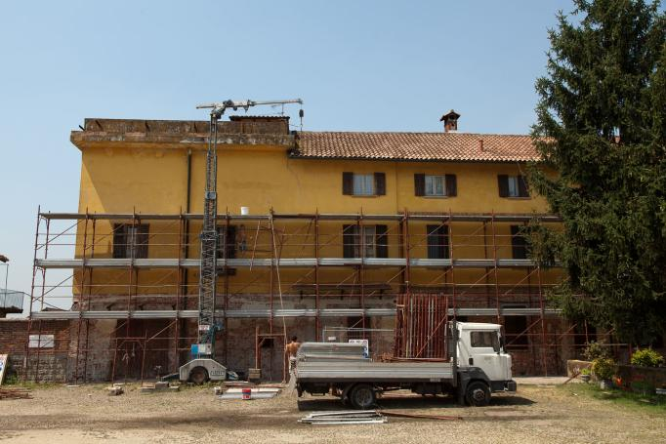
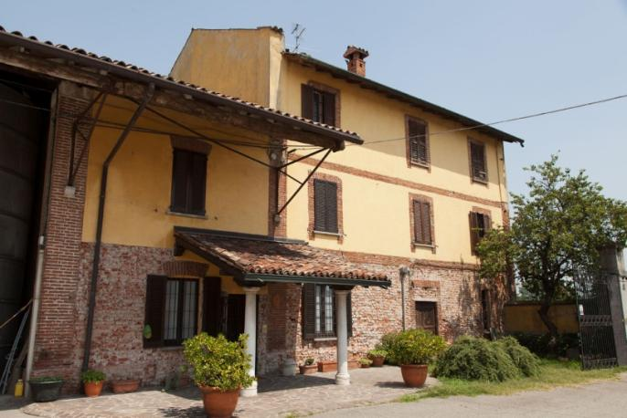
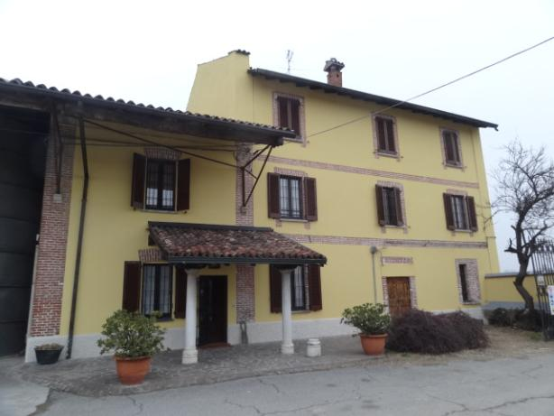
Construction site example

Slide 49
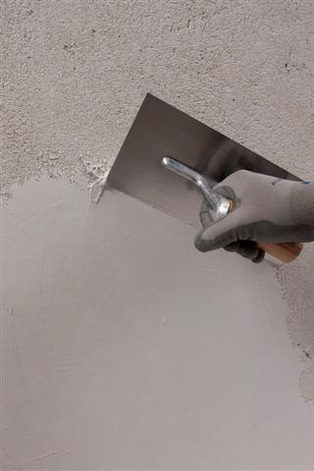
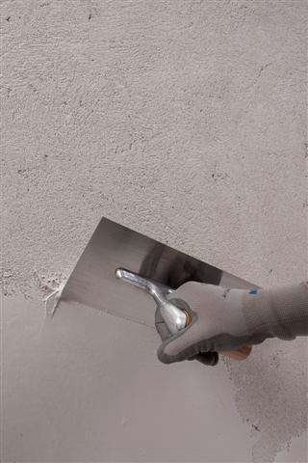
< 100 µm
Application of MAPE-ANTIQUE FC Ultrafine

Slide 50
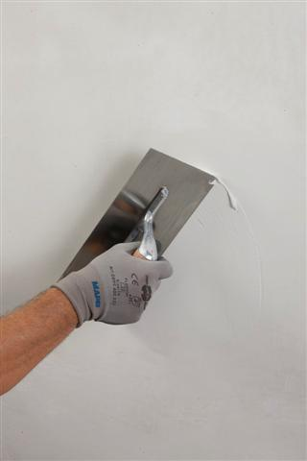
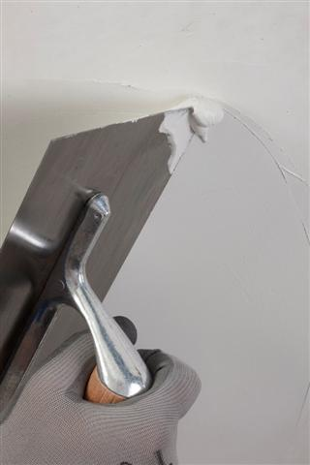
Application of MAPE-ANTIQUE FC Ultrafine

Slide 51
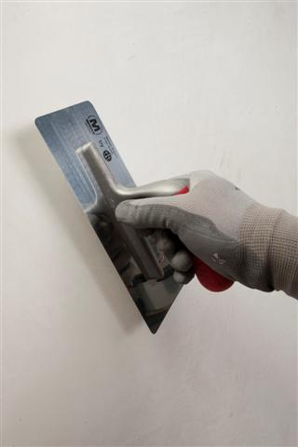
Smoothing of MAPE-ANTIQUE FC Ultrafine

Slide 52
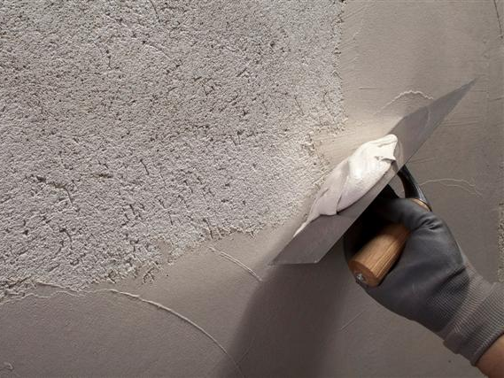
400 µm
Application of MAPE-ANTIQUE FC Civile

Slide 53
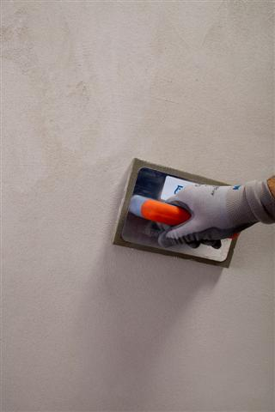
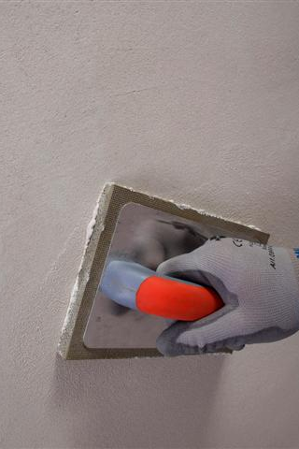
Sponging MAPE-ANTIQUE FC Civile

Slide 54
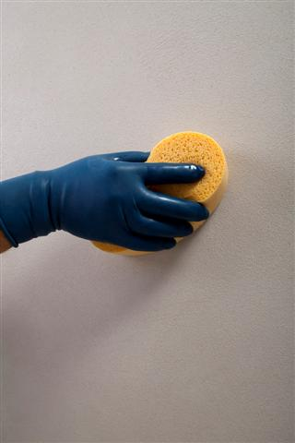
Sponging MAPE-ANTIQUE FC Civile

Slide 55
700 µm
Application of MAPE-ANTIQUE FC Grosso

Slide 56
Sponging MAPE-ANTIQUE FC Grosso

Slide 57
Sponging the surface

Slide 58
Application of the coloured finishing by float

Slide 59
Sponging of the coloured finishing

Slide 61
STRUCTURAL RENDER

Slide 64
Applying the structural render

Slide 65
Applying the structural render

Slide 66
Squaring off the structural render

Slide 67
Levelling off the structural render

Slide 68
Applying the coloured finishing

Slide 69
Applying the coloured finishing

Slide 71
STRUCTURAL RENDER + MESH

Slide 72
Particular of the structural renders + zinc plated mesh

Slide 73
Fastening the glass fibers mesh

Slide 74
Fastening the glass fibers mesh

Slide 75
Fastening the glass fibers mesh

Slide 76
Checking the gap between the mesh and the substrate

Slide 77
with GLASS FIBERS MESH
with ZINC PLATED MESH

Slide 78
with ZINC PLATED MESH
with MAPENET EM 30 and MAPENET EM 40

Slide 83
HISTORIC CENTRE OF NEPI (VT)
Re-rendering with MAPE-ANTIQUE INTONACO NHL

Slide 84
3.2 RESTORATION
Renders reconstruction
MUSEO SALINAS - PALERMO

Slide 85
TRANSPIRANT RENDER
TRANSPIRANT render
DEHUMIDIFING render

Slide 88
MAPE-ANTIQUE INTONACO NHL
Transpirant render
Transpirant base render based on natural hydraulic lime and
Eco-Pozzolan, for application on existing masonry, including that of historical interest and on new construction
MAPE-ANTIQUE line

Slide 89
Continuous-feed rendering machine

Slide 90
MUSEO SALINAS (PA)
Creating new dehumidifying and transpirant renders with the products of
MAPE-ANTIQUE SILEXCOLOR and SILANCOLOR ranges

Slide 91
Application of MAPE-ANTIQUE INTONACO NHL

Slide 93
Application of transpirant render

Slide 94
Application of transpirant render

Slide 95
Squaring the transpirant render

Slide 96
Overview of an inside room

Slide 97
Applying the coloured finishing

Slide 98
Applying the coloured finishing

Slide 99
Detail of SILEXCOLOR TONACHINO

Slide 100
Overview of an inside room

Slide 102
Outside overview

Slide 103
Outside overview

Slide 104
Outside pverview

Slide 105
INJECTION SLURRIES FOR THE RE-ADHESION OF RENDERS, ALSO FRESCOED, TO WALLS
BASILICA OF ST. FRANCIS – ASSISI ( ITALY ) ( since year 1228 )

Slide 111
Reconstruction of the vaults with the masonry mortar

Slide 112
Reconstruction of the vaults with the masonry mortar

Slide 113
Reconstruction of the vaults with the masonry mortar

Slide 115
By using this slurry there is no need to soak the masonry
It is suggested for consolidating frescoed renders
It is physically and chemically compatible with the masonry
It doesn’t react with a possible presence of soluble salts
Consolidation of the intrados with the slurry

Slide 116
Consolidation of the intrados with the slurry

Slide 117
Consolidation of the extrados with the slurry

Slide 118
3.1 CONSOLIDATION
Re-establishing the renders adhesion

Slide 119
INJECTION SLURRIES FOR THE RE-ADHESION OF RENDERS, ALSO FRESCOED, TO WALLS
CAROVANA PALACE – HIGH SCHOOL PISA ( ITALY )

Slide 120
Injection of the slurry ( super-fluid, salt-resistant, fillerized hydraulic binder )

Slide 121
Injection of the slurry ( super-fluid, salt-resistant, fillerized hydraulic binder )

Slide 122
INJECTION SLURRIES FOR THE STRUCTURAL CONSOLIDATION
CAEN CASTLE – CAEN ( FRANCE )

Slide 124
Mixing of the slurry

Slide 125
Rubble masonries, cracks etc.

Slide 126
Injection of the slurry ( super-fluid, salt-resistant, fillerized hydraulic binder )

Slide 128
NEW

Slide 129
NEW
MAPE-ANTIQUE
ECOLASTIC
Rivestimento bicomponente:
ELASTICO
PROTETTIVO
(resiste agli agenti atmosferici e ai raggi UV)
IMPERMEABILE
RESTISTENTE AI SALI
ESENTE DA CEMENTO
RESISTENTE ANCHE A SPINTA NEGATIVA (strutture interrate)

Slide 135
PRIMA
DOPO

Slide 136
TWO-COMPONENT COATING
ELASTIC
LIME BASED
CEMENT-FREE
SALT-RESISTANT
UV-RESISTANT
FOR WATERPROOFING AND PROTECTING CONSTRUCTION ELEMENTS, INCLUDING IN LISTED BUILDINGS

Slide 137
DUCA DEGLI ABRUZZI COMPLEX – BARI ( ITALY )

Slide 138
SAN PIERO A GRADO – PISA ( ITALY )

Slide 139
CAROVANA PALACE – HIGH SCHOOL – PISA ( ITALY )

Slide 140
PETRUZZELLI THEATRE – BARI ( ITALY )

Slide 141
DOMUS AUREA – ROME ( ITALY )

Slide 142
ANGIOINO CASTLE – COPERTINO ( ITALY )

Slide 143
SALINAS ARCHAEOLOCICAL MUSEUM PALERMO ( ITALY )

Slide 144
PEGGY GUGGENHEIM MUSEUM – VENICE ( ITALY )

Slide 145
BARD FORTRESS – AOSTA ( ITALY )

Slide 148
PALAZZO VECCHIO (rear facade) FLORENCE ( ITALY )

Slide 149
PORTA BOZZOLO VILLA – CASALZUIGNO ( ITALY )

Slide 150
PASSION ORATORY S. AMBROGIO BASILICA – MILANO ( ITALY )

Slide 151
VILLA REALE – MILANO ( ITALY )

Slide 152
BASILICA OF ST. FRANCIS – ASSISI ( ITALY )

Slide 153
CARLO BRIDGE – PRAGA ( CZECH REPUBLIC )

Slide 154
LIFE PALACE HOTEL, SIBENIK ( CROATIA )

Slide 155
CLAY CASTLE – SIBIU ( ROMANIA )

Slide 156
CLAY CASTLE – SIBIU ( ROMANIA )

Slide 157
JESUIT FATHERS MONASTERY STARA WEIS ( POLAND )

Slide 158
CAEN CASTLE – CAEN ( FRANCE )

Slide 159
THANK YOU FOR YOUR ATTENTION
Archt. Davide Bandera Mobile +39 335 1303126
d.bandera@mapei.it

